Slide 1
HealthTech
Team 'Rockers'

Slide 2
Team Members..
Chirag Chetnani
Shikhar Tiwari
Kush Sharma
Anjali Hasani

Slide 3
Webapp for healthtech
Hello,
We would like to submit my project proposal under the topic "HealthTech"
We have thought of making a WebApp, implementing two functionalities as mentioned below:
1. Symptoms diagnosing and assisting with Over-the-Counter Medicines prescription
&
2. For Maintaining a nation-wide Database of patient medical records to enable an efficient system for patient and doctor centered information exchange.

Slide 4
Description:
In the first functionality, we will ask patients for their symptoms and search in our DB(Data Base) for most appropriate diseases which they might have and we will provide them some medicines which could be taken without the prescription of doctors. If a patient's symptoms don't match with symptoms of diseases in our DB then we will advise them to consult a doctor. For this part, we will search for diseases and their symptoms and populate them in our DB.
In the second functionality, we will make an architecture for information exchange between patients and doctors. The main attribute of this functionality would be maintaining chronological record of the patient's information. It will encompass data regarding various aspects of patients

Slide 5
like general & demographic information, personal and family history, treatment and investigations prescribed, etc. All this information will be linked to patient's unique Aadhar id or mobile number.
This will make all information and records very easily accessible to all healthcare workers for future use and reference. In this, the treating doctor can edit or can change the report according to him and patient will only be able to see what all tests have gone through. This feature could also be used to roll out the COVID-19 vaccine throughout India. This will make it easy to track down people for getting vaccinated.

Slide 6
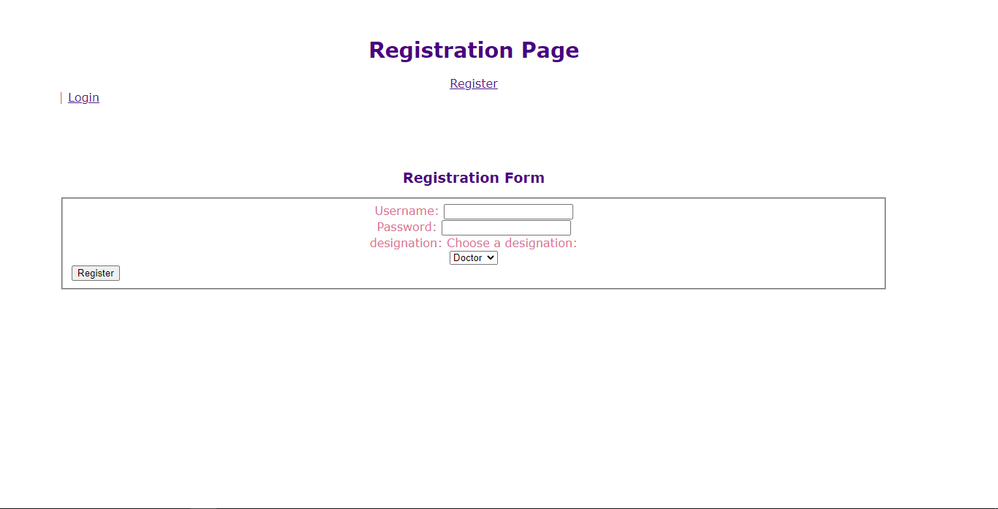
ABOUT REGISTRATION PAGE
This is the front-end registration page of healthtech using HTML; CSS; PHP.

Slide 7
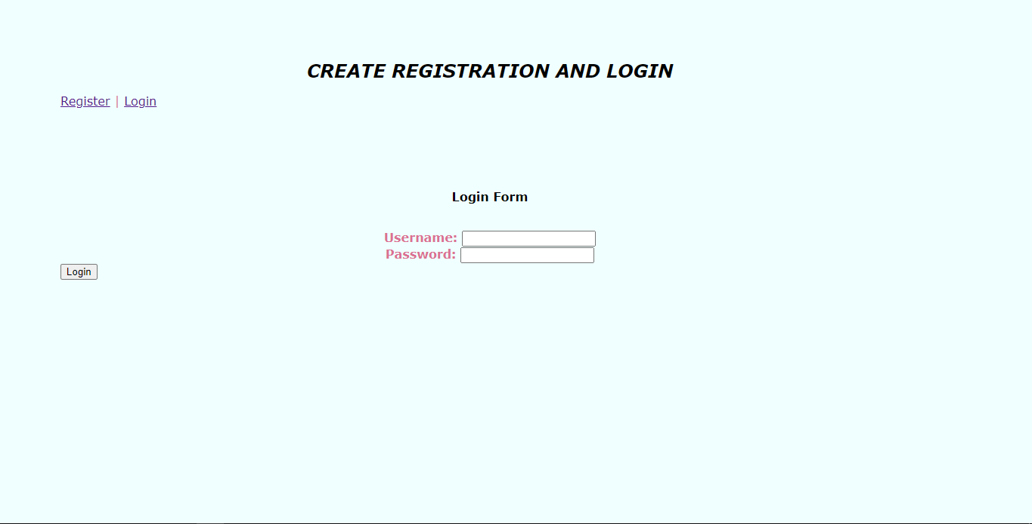
This is the login page where patients and doctors can login and from here the rights of both will be defines that patient can only see the data but doctor can edit it or can replace it with the new data(patients reports)

Slide 8
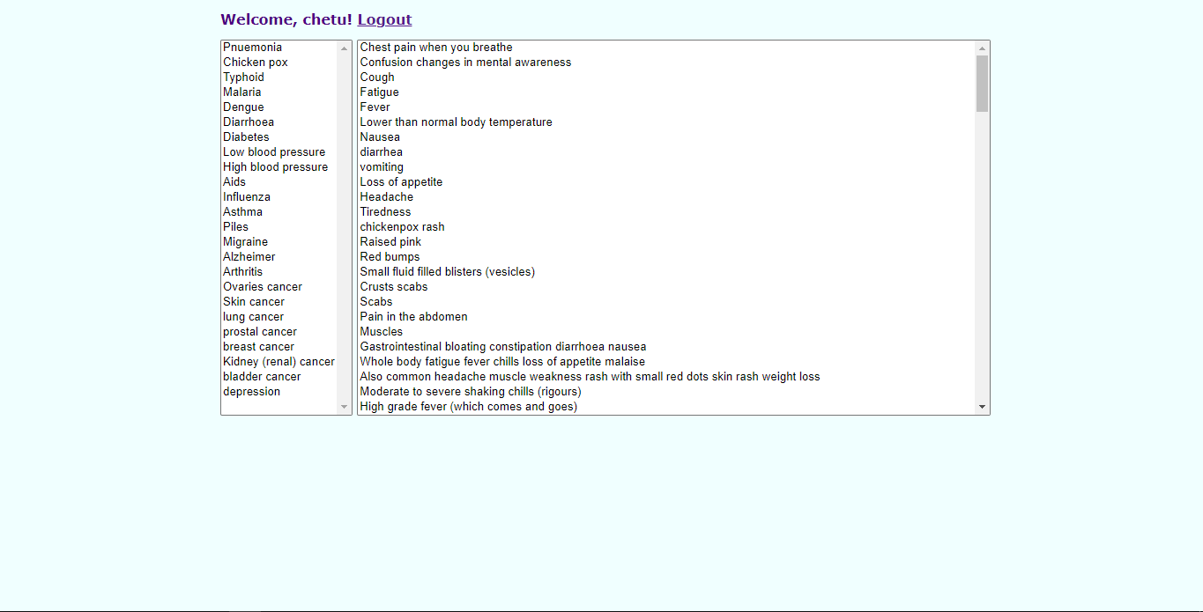
This is the first page which comes to both the Patient and the Doctor after they login which gives them the option to select there disease or just select the multiple symptomes on the basis of this the webapp will provide some medicines which can be taken off without Doctor’s prescription and will suggest you what to do next. And from here we will define a drop down menu box which will be defining the rights of the Patient and the Doctor

Slide 9
Note
The further work is in progress and we will try to complete it as soon as possible …..

Slide 10

Team 'Rockers'

